Slide 1

Uncharted Waters | Investor Perspectives on the 2020 Global VC Scenario
2020 YTD Trends in VC+Tech Dealmaking
By Julie Ruvolo, Managing Director of Venture Capital, EMPEA

Slide 2

2020 YTD | Uncharted Waters
The Covid-19 effect: There’s a lot we still don’t know.
Ratcheting geopolitical tensions: How will this affect the flow of private capital into tech deals?
The TikTok dilemma: Who gets to go cross-border in 2020?

Slide 3

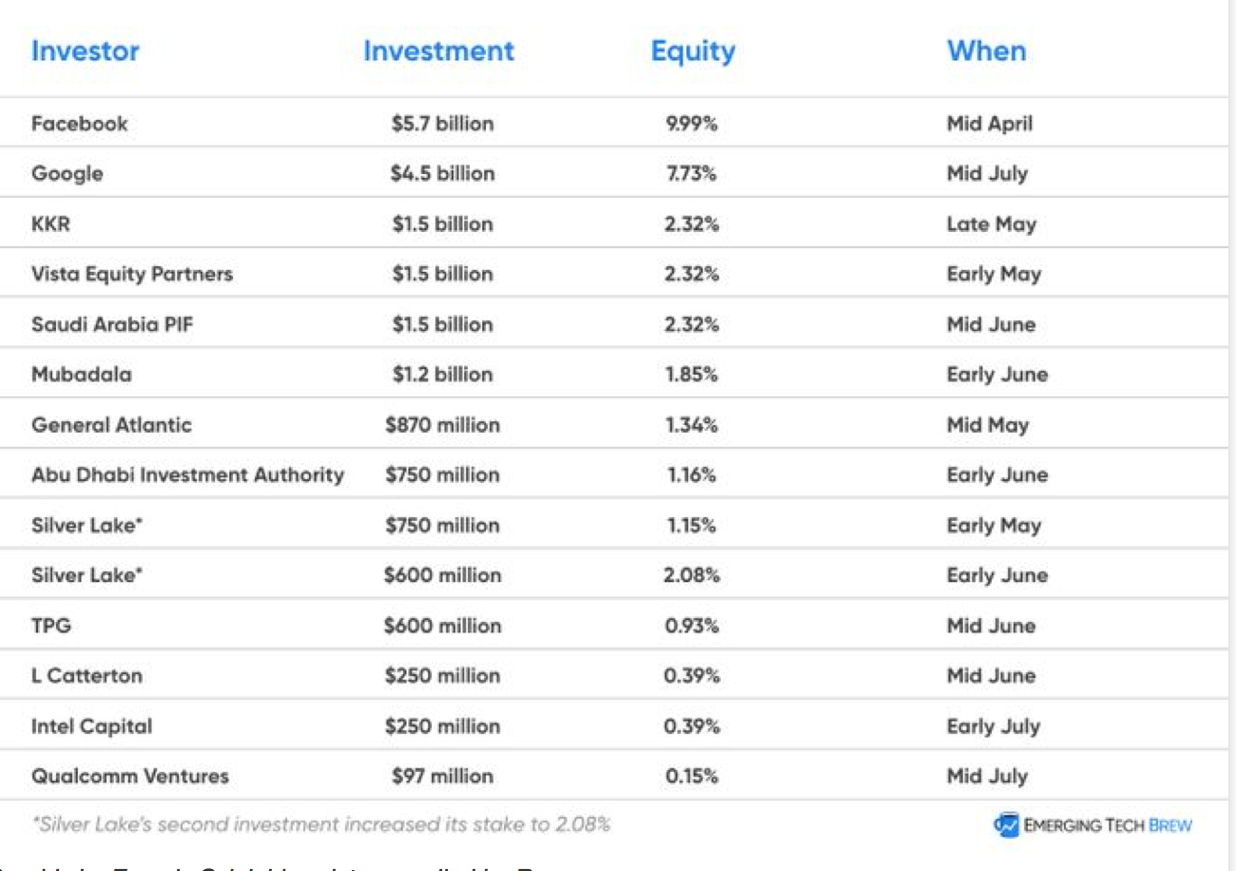
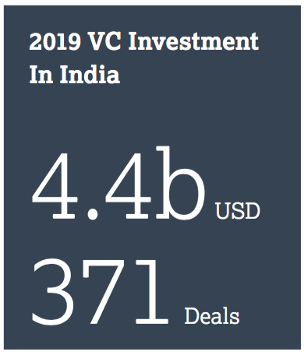
India | The Jio Party
Reliance Industries sold off ~33% of the equity in Jio Platforms to Facebook and others for a combined USD20b+, reducing its debt and super-charging its strategic plans for telco-to-digital dominance in the Indian market.
2020 YTD Disclosed Investments in Jio Platforms

Slide 4




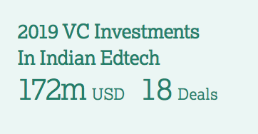

India | Edtech in Focus
Vedantu raised a USD100m Series D at a reported USD600m valuation from Coatue Management, Tiger Global, GGV Capital, Westbridge, and Omidyar Network.
College prep edtech Byju’s raised an undisclosed round from Bond Capital at a reportedly sizable valuation.
Unacademy raised USD110m from General Atlantic, Facebook, Sequoia India, Nexus Venture Partners, Steadview Capital, and Blume Ventures. Flipkart CEO Kalyan Krishnamurthy and Udaan co-founder Sujeet
Kumar also participated.
Workforce upskilling edtech Degreed raised USD32m
led by Owl Ventures.

Slide 5





India | One Deal to Watch: ZOMATO
Uber sold its UberEats operations to Indian grocery delivery giant Zomato
for USD350m in January 2020.
A USD100m investment from Ant Group in Zomato is pending government approval amidst growing restrictions on inbound Chinese investment. Ant Financial already has a 25%+ stake in Zomato, with over USD500m invested.

Slide 6





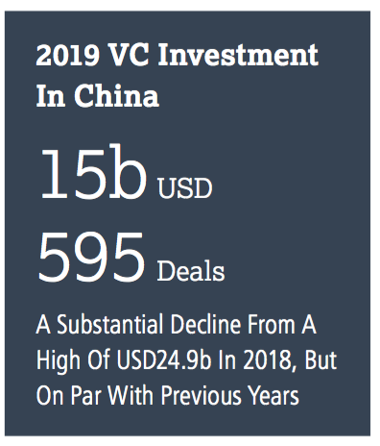



China | Biotech in Focus
MGI Tech, a manufacturer of gene sequencing devices, raised a USD1b Series B led by IDG Capital and CPE (formerly CITIC Private Equity).
Everest Medicines raised a USD310m Series C led by Janchor Partners, RA Capital Management, Hillhouse Capital, and Jiashan SDIC.
Haihe Biopharma, a cancer drug developer, raised a USD171m Series B from Warburg Pincus.
Genor Biopharma, a clinical stage biotech commercializing therapeutic antibodies, raised a USD160m Series B led by Hillhouse Capital Group.
Antengene, a developer of oncology therapeutics, raised a USD97m Series C led by
Fidelity Management.
OBiO Technology, a CRO for viral based gene therapy, raised a USD28m pre-Series C
led by Efung Capital.
Immvira, a developer of immunotherapies and cancer treatments, raised
a USD58m Series B led by Huagai Capital.

Slide 7





China | Edtech in Focus
Yuanfudao raised a USD1b Series G led by Hillhouse, Boyu Capital, and IDG.
Zuoyebang raised a USD750m Series E led by FountainVest and Tiger Global.
Art tutoring platform Meishubao raised a USD40m Series C+ led by Tencent.
Math- and science-focused Huohua Siwei raised a USD30m Series D+ from local video-sharing giant Kuaishou.
Art- and culture-focused Qinhan Hutong raised USD21m Series B from education company Mingde Chuancheng.

Slide 8

China | Sector to Watch: Industrial Robotics
WAREHOUSE
ROBOTS
Geek+ raised a USD50m Series C extension from V Fund, Redview Capital, and Vertex Ventures, after raising a USD150m Series C1 in 2019 led by GGV Capital, D1 Capital, and Warburg Pincus.
Keenon Robotics raised a USD28m Series B led by Source Code Capital, Walden International, and others.
Pudu Technology raised a USD15m Series B from Meituan.
VisionNav Robotics raised a USD14m Series B led by Lenovo Capital.
Galaxis Technology raised a USD14m Series D led by China Capital Investment Group with Oriza Holdings, Huagai Capital, and others.
Mech-Mind Robotics raised a USD14m Series B led by Sequoia Capital China.
Syrius raised a USD10m Series A+ led by Sequoia Capital China.
RESTAURANT
SERVICE ROBOTS
INDOOR
DELIVERY ROBOTS
industrial
autonomous
vehicle tech
LOGISTICS
ROBOTS
INDUSTRIAL
SORTING ROBOTS
WAREHOUSE
ROBOTS

Slide 9






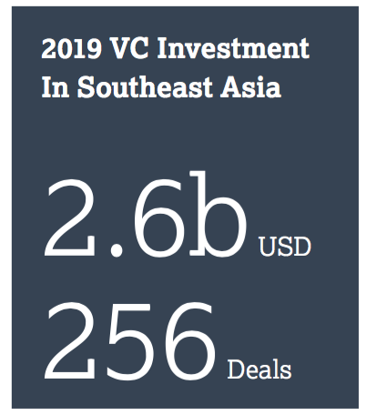


Southeast Asia | Big Tickets
Ninja Van, a Singapore-based package delivery logistics platform, raised a USD279m Series D from Monk’s Hill Ventures, GGV, B Capital Group, Grab, and others.
Kopi Kenangan, an app-driven grab-and-go coffee chain in Indonesia, raised a USD109m Series B led by Sequoia Capital India with B Capital, Singaporean family office Kunlun, and others.
Kargo Technologies, an Indonesian logistics startup founded by ex-Uber Asia exec Tiger Fang, raised a USD31m Series A from Tenaya Capital, Sequoia India, Mirae Asset Management, and Intudo Ventures.
Synqa (formerly Omise Holdings), a Thailand-based digital payments fintech, raised a USD80m Series C led by SCB 10X, the VC arm of Siam Commercial Bank, and asset manager Sparx Group.
Digital wallet fintechs Ovo (backed by Grab and SoftBank) and Dana (backed by Ant
Group) announced a merger to compete against GoPay.
Plus Ongoing Rounds for Grab and Gojek
Grab reportedly raised USD856m from Mitsubishi UFJ Financial Group and TIS.
Gojek raised USD1.2b from undisclosed investors in March. Facebook and PayPal reportedly joined the cap table in June. Video streaming arm GoPlay raised undisclosed capital in response to Tencent’s acquisition of iFlix in Malaysia.

Slide 10







Southeast Asia | Healthtech in Focus
Doctor Anywhere, a Singapore-based telehealth platform, raised a USD27m Series B led by Square Peg Capital.
Holmusk, a Singapore-based healthtech focused on behavioral health, raised a USD21.5m Series A led by Optum Ventures and Health Catalyst Capital.
Travecta Therapeutics, a Singapore-based therapeutics biotech focused on the central nervous system, raised a USD15m Series A led by TKS1.
Hummingbird Bioscience, a Singapore- and US-based biotherapeutics startup, raised a USD6m Series B extension led by SK Holdings, bringing the total round to USD25m.
Eko.ai, a machine learning platform
for reading echocardiograms, raised
USD4m in a seed round led by
Sequoia India and EDBI.

Slide 11



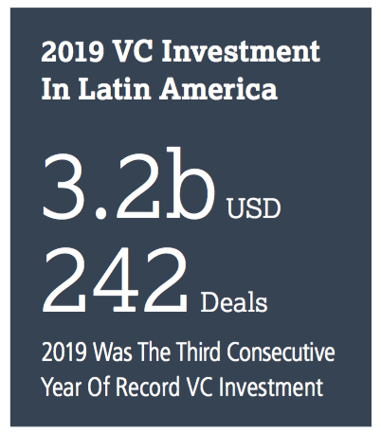

Latin America | Logistics in Focus
Brazilian trucking logistics platform CargoX raised a USD80m Series E led by LGT Lightstone Latin America, with follow-on from Goldman Sachs Growth Equity, Valor Capital, and Farallon Capital.
Tembici, a Brazilian micro-mobility platform focused on bikes,
raised a USD47m Series B led by Valor Capital and Redpoint
eventures.
Liftit, a B2B Colombian logistics marketplace for
independent truck drivers, raised a USD22.5m Series B
led by PE firm Cambridge Capital.

Slide 12




Latin America | Healthtech in Focus
Conexa Saúde, a Brazilian telemedicine marketplace, raised a USD40m Series B led by General Atlantic and e.Bricks Ventures.
Alice, a Brazilian health care provider founded by founders of rideshare 99 and healthtech Dr. Consulta, raised a USD16m round from Canary, KaszeK Ventures, and MAYA Capital.
Pipo Saúde, a Brazilian employee health plan management platform, raised a USD4.6m round from monashees, KaszeK Ventures, ONEVC, and Nubank CEO David Velez.

Slide 13







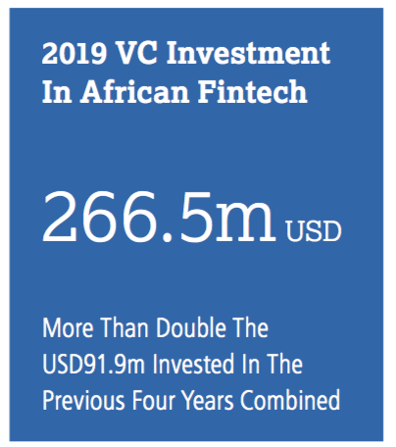
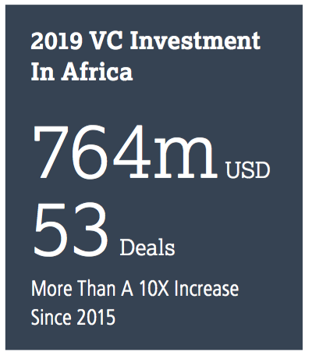

Africa
Healthtech in Focus
Fintech in Focus
mPharma, a Ghana-based prescription drug inventory management platform, raised a USD17m Series C from Novastar, CDC Group, Dompe Holdings, and others.
Vezeeta, an Egypt-based doctor appointment booking platform, raised a USD40m Series D from Gulf Capital, Saudi Technology Ventures, and others.
Zipline, a Silicon Valley-based drone
delivery startup for medical supplies
operating in Rwanda and Ghana,
launched operations in the US to
assist with C19-related medical deliveries.
Zipline raised the largest disclosed
VC round in 2019 (USD190m) from
TPG, Katalyst Ventures, and
Oakhouse Partners.
South African fintech Jumo raised USD55m in debt and equity from Goldman Sachs, Leapfrog Investments, and Odey Asset Management.
UK-based, Africa-focused Flutterwave raised a USD35m Series B led by Greycroft Partners and eVentures.
California-based, Africa-focused Chipper Cash raised USD13.8m from Deciens Capital and Raptor Group.
Questions around Nigeria-
based OPay and predatory
lending.
OPay raised USD170m
across two rounds in
2019, in two of the
largest disclosed VC
transactions in Africa.

Slide 14





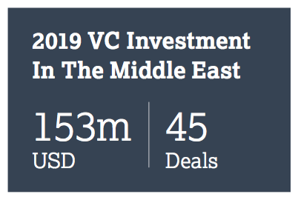
Middle East
The Big Ticket
#EXIT 2020 kicked off with the completion of Uber’s previously announced USD3.1b acquisition of UAE-based ride-hailing company Careem, a deal that provided exits for regional investors including Wamda Capital and Lumia Capital.
Food Logistics in Focus
Kitopi*, a New York- and Dubai-based cloud kitchen operator, raised a USD60m Series B led by Lumia Capital and Knollwood.
Jahez*, a Saudi Arabia-based food delivery platform, raised a USD36m Series A led by Impact46.
Nana Direct, a Saudi Arabia-based grocery delivery platform, raised a
USD18m Series B from Wamda Capital, Saudi Technology Ventures,
Middle East Venture Partners, Saudi Venture Capital Company, Impact46,
and Watar Partners.
*The Kitopi and Jahez deals exceed the largest disclosed VC round for the Middle East in 2019, when trucking aggregator Trukker raised USD23m.

Slide 15





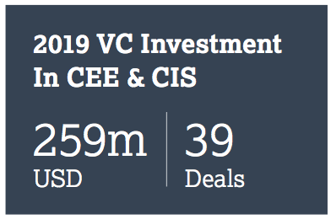

CEE & CIS
The Big Ticket
Riding the C19 Wave
BestDoctor, a Russian medical health insurance and medical consultation provider, raised a USD4.5m Series A from Moscow-based AddVenture and Berlin-based Target Global, with follow-on from the London-based LVL1 fund.
Spaceti, a Czech Republic-based proptech focused on servicing workplaces, raised a EUR3.5m seed round from Lighthouse Ventures and Czech footballer Kamil Vacek, with follow-on from Reflex Capital and Fast Forward. Spaceti’s software analyzes the use of work spaces and the air quality within those rooms.
Lithuania-based Ziticity, which enables local business owners to provide same-day delivery, raised a EUR2.2m seed round led by NordicNinja VC, with Superhero Capital, Practica Capital, and others.
Green Fox Academy, a Hungary-based online programming edtech, raised EUR1.3m from Impact Ventures.
#EXIT Earlybird Venture Capital exited Turkish mobile game developer Peak Games for USD520m as part of a USD1.8b cash+stock sale to Zynga. Peak was acquired at a unicorn valuation. Other shareholders include Hummingbird Ventures, Endeavor Global, and Peak Games CEO and Founder Sidar Sahin. The deal is expected to close in Q3 2020.
Peak Games is Zynga’s largest acquisition to date; Zynga previously acquired game assets from Peak Games.

Slide 16

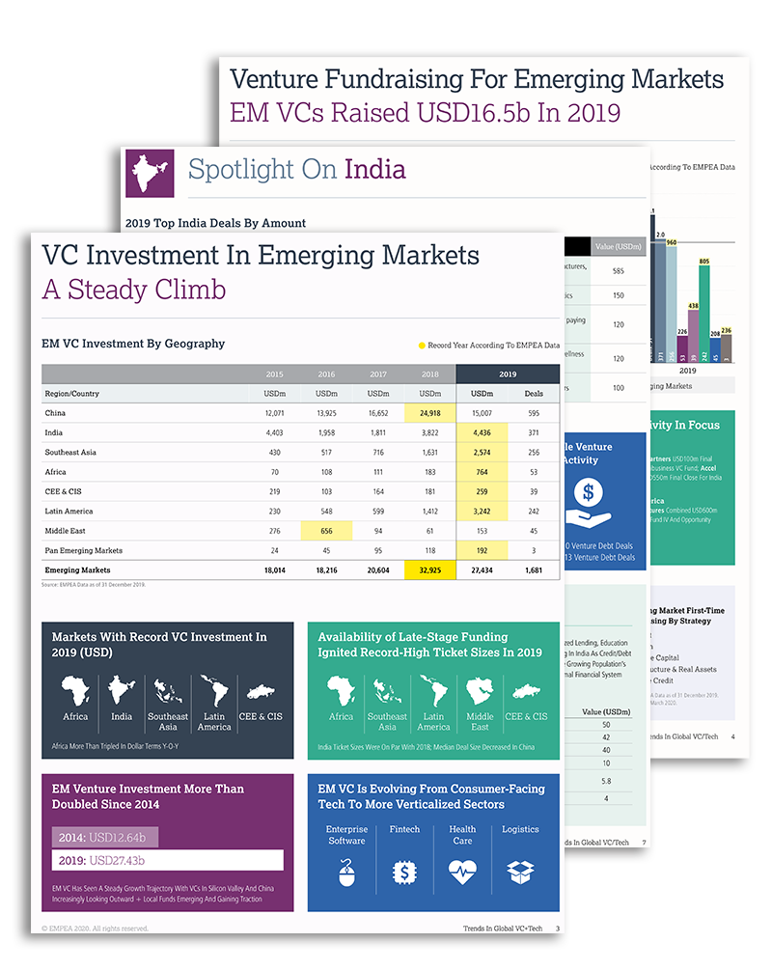
EMPEA Resources
SUBSCRIBE
DOWNLOAD
Access Trends in Global VC+Tech, EMPEA’s inaugural report on venture-backed startups across emerging markets which includes 2019 data on VC fundraising and investments, as well as market breakdowns including top VC deals by size, most active venture investors, and tech sector highlights.
empea.org/vc-tech/ | ruvoloj@empea.net

Slide 17
589 Eighth Avenue • 18th Floor • New York, NY 10018 USA
Phone: +1 646 315 6735 • Web: empea.org
© EMPEA 2020. All rights reserved.

